Slide 1


Leveraging Koopman operator and Deep Neural Networks for Parameter Estimation and Future Prediction of Duffing oscillators. Y. Riyazi, N. Ghanbari, A. Bahrami* Mechanical Engineering department, University of Tehran y.riyazi@ut.ac.ir

Slide 2
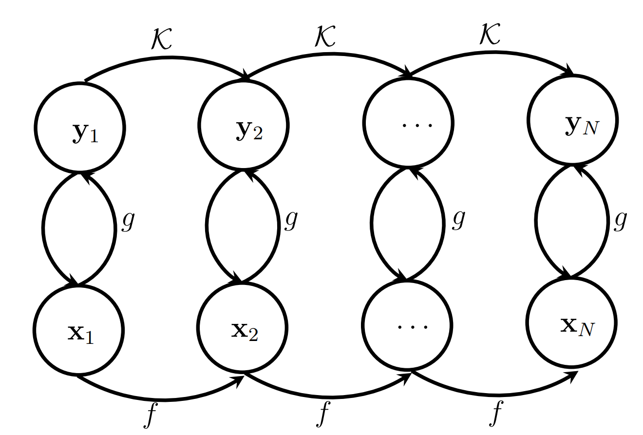

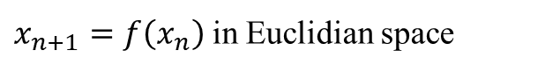
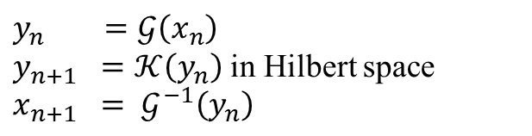
Introduction: The Koopman Operator
$$y_{n} =𝒢\left(x_{n}\right)$$
$y_{n+1} =𝒦\left(y_{n}\right)$ in Hilbert space
$$x_{n+1} = 𝒢^{−1}\left(y_{n}\right)$$
Koopman Operator Linear properties
$$y_{n+m} =\underset{m times}{\underbrace{𝒦\left(𝒦\left(𝒦\left(⋯𝒦\left(y_{n}\right)\right)\right)\right)}}$$
$=A^{m}$ $y_{n}$
$x_{n+1}=f\left(x_{n}\right)$ in Euclidian space
Figure 1. The Koopman Operator (Image by Author).

Slide 3
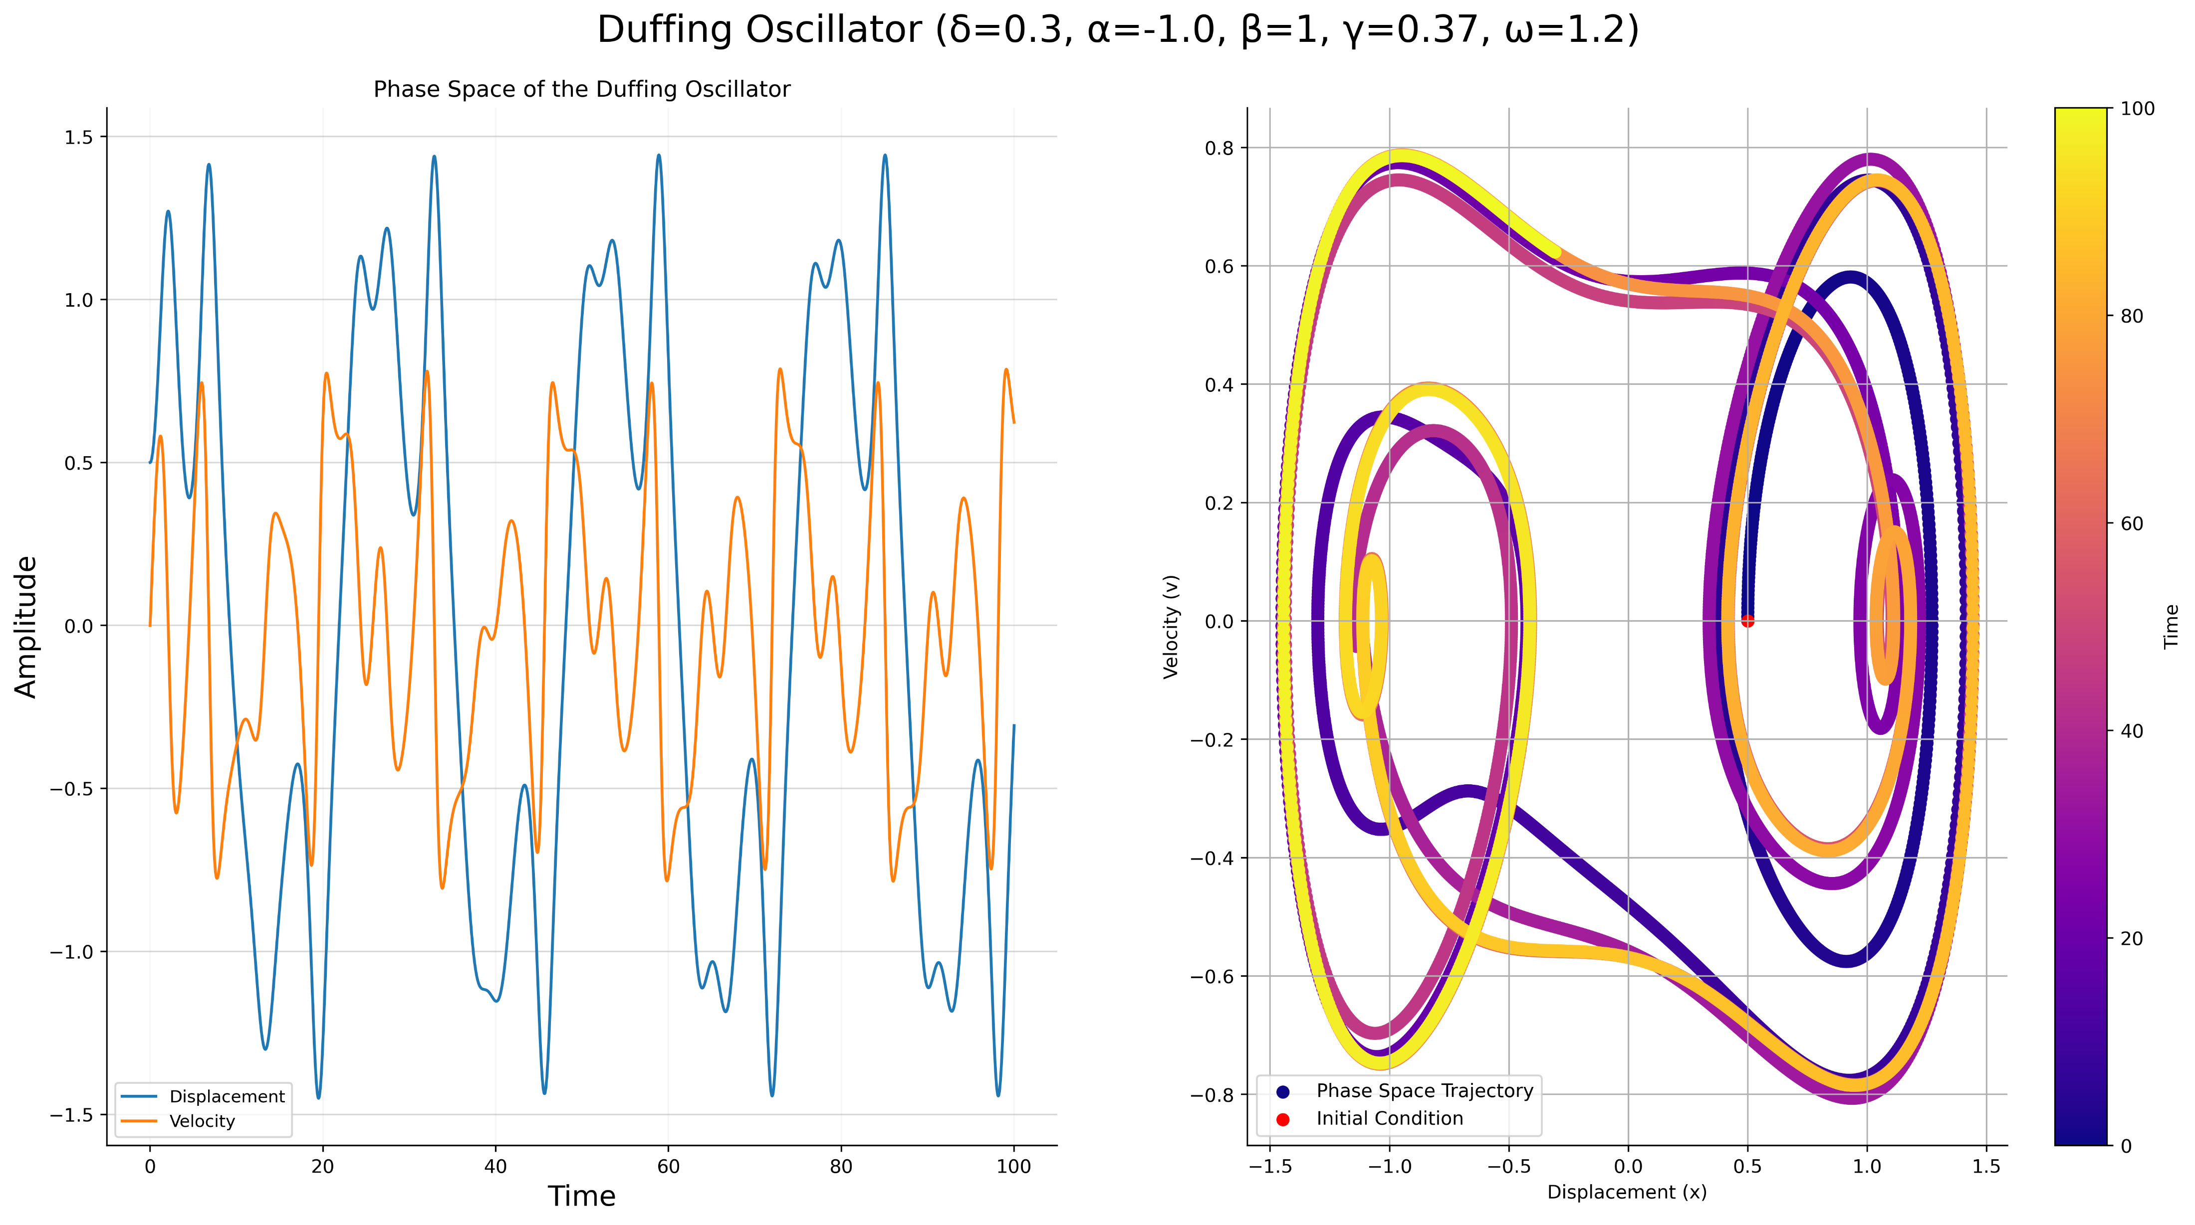
Introduction: The Koopman Operator
Figure 2. Numerical result of Duffing oscillator (Image by Author).

Slide 4
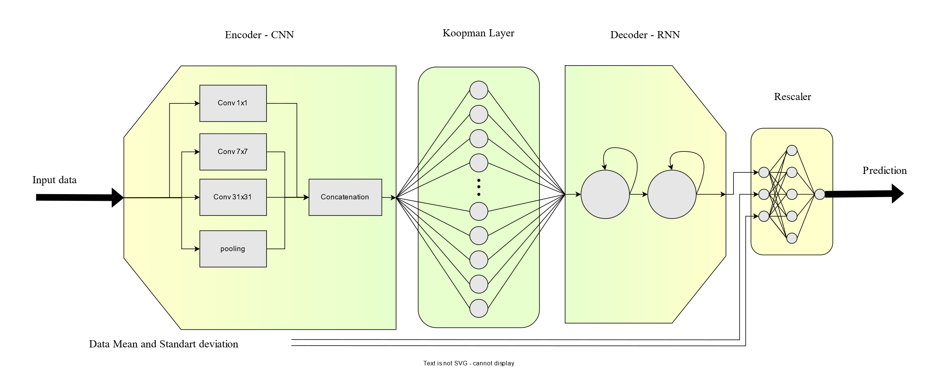
Network: Structure
Figure 3. Network’s Diagram (Image by Author).

Slide 5
Network: Encoder
CNN
Similar to Frequency transformations
Considering different Time scales with different Convolutional filter size.
Inception
Considering different Time scales with different Convolutional filter size.
Not dependent to input size
Improving Back propagation Flow
We encode one in training but use the the model auto regressively.
Figure 4. Network’s Diagram (Image by Author).

Slide 6
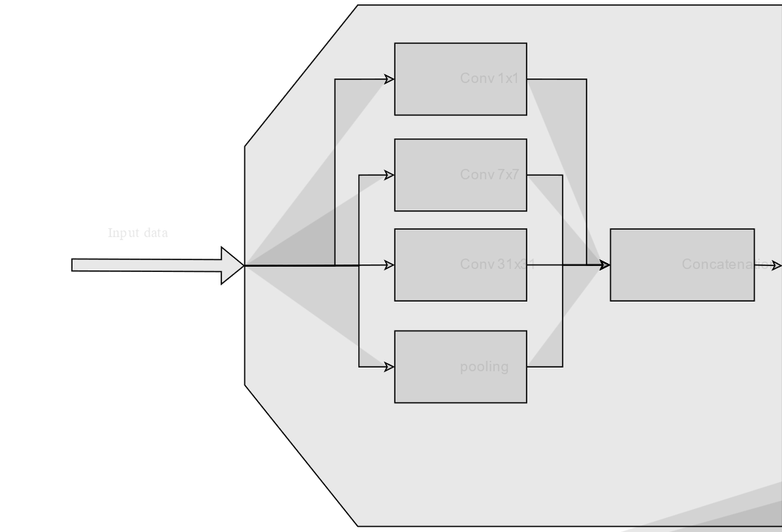
Network: The Koopman Evolution Matrix
This layer designed to serve as the Koopman operator evolution matrix.
NO Bias.
NO Activation Function !!!
Figure 5. Network’s Koopman Linear Layer(Image by Author).

Slide 7
Network: Normalization
Figure 6. Network’s structure –Rescaler (Image by Author).

Slide 8
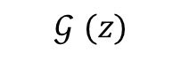
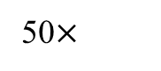

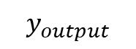
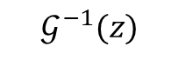
Network: The Koopman Evolution Matrix
50$×$
According to Koopman Operator theory, the evolution matrix is a
$$𝒢^{−1}(z)$$
$$ℒ\left(A^{50}y_{n},𝒢^{ }(y_{n+50})\right)$$
$$y_{output}$$
$$𝒢^{ }(z)$$
Figure 7. Network’s Koopman Linear Layer(Image by Author).

Slide 9
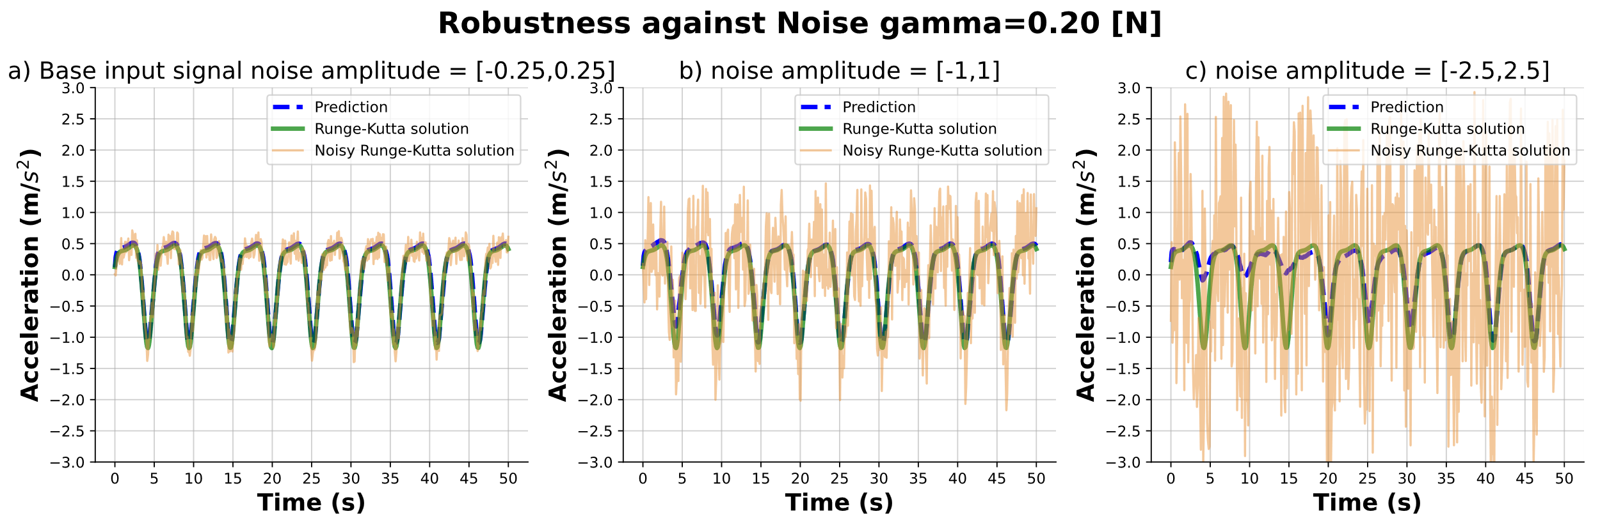
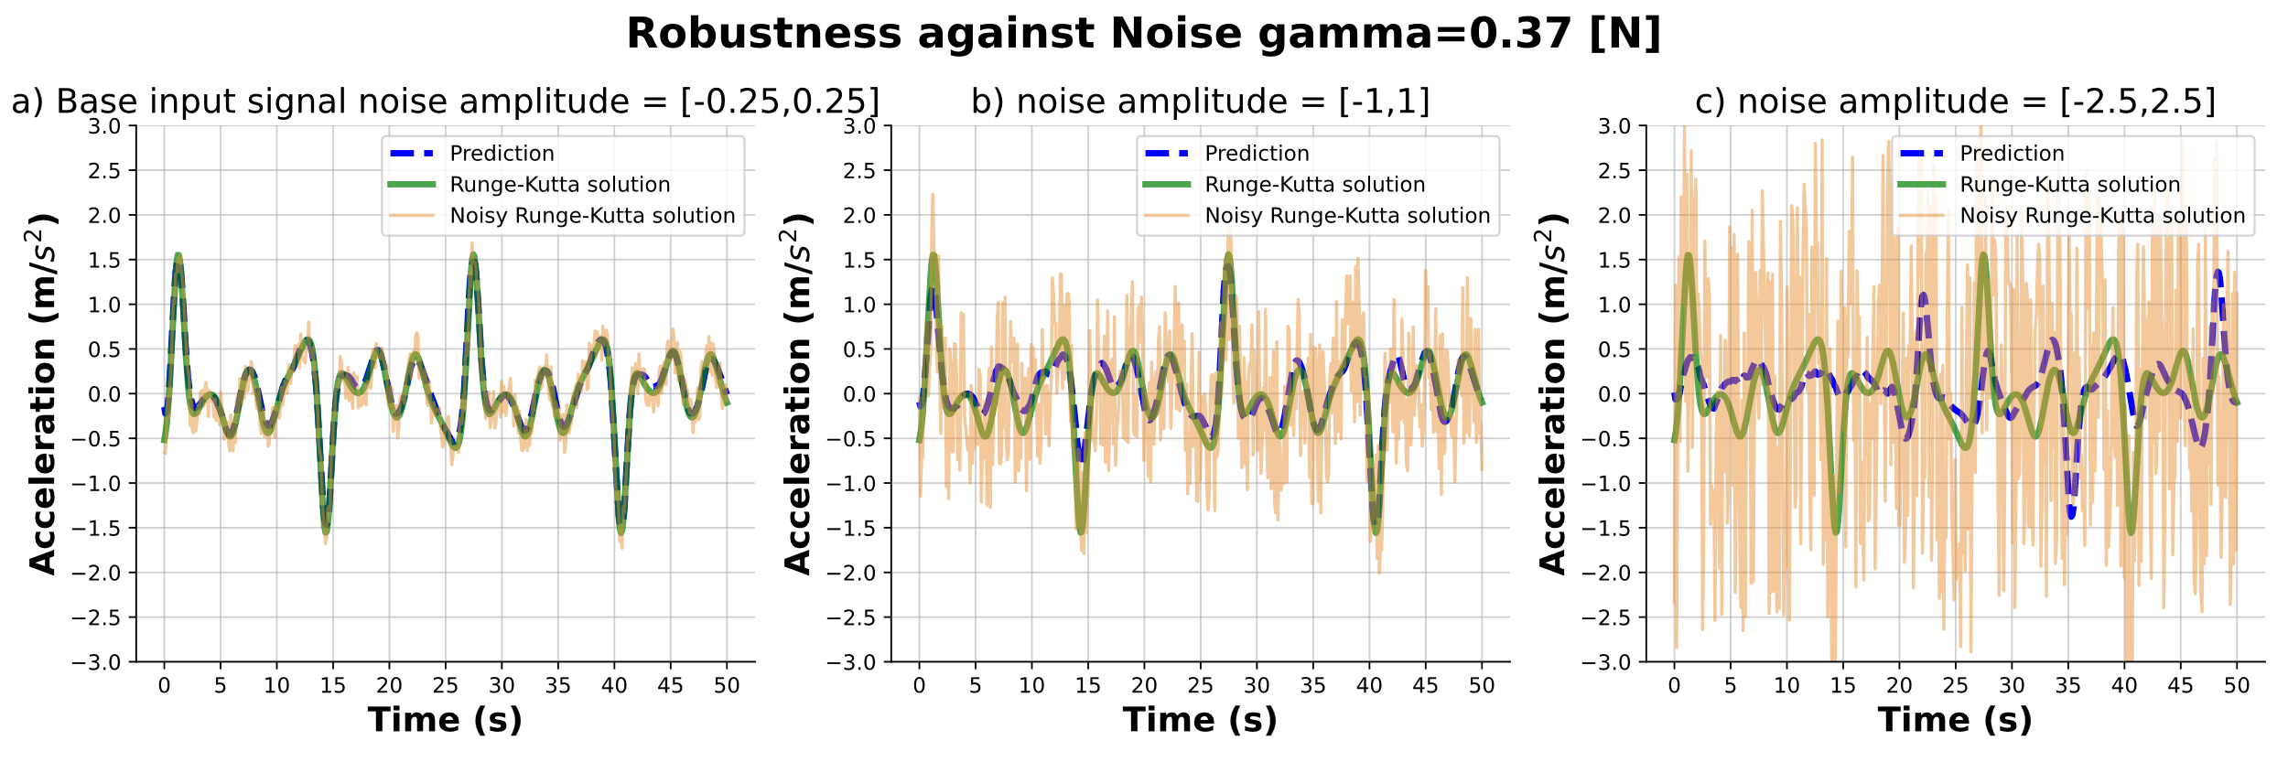
Introduction: The Koopman Operator

Slide 10
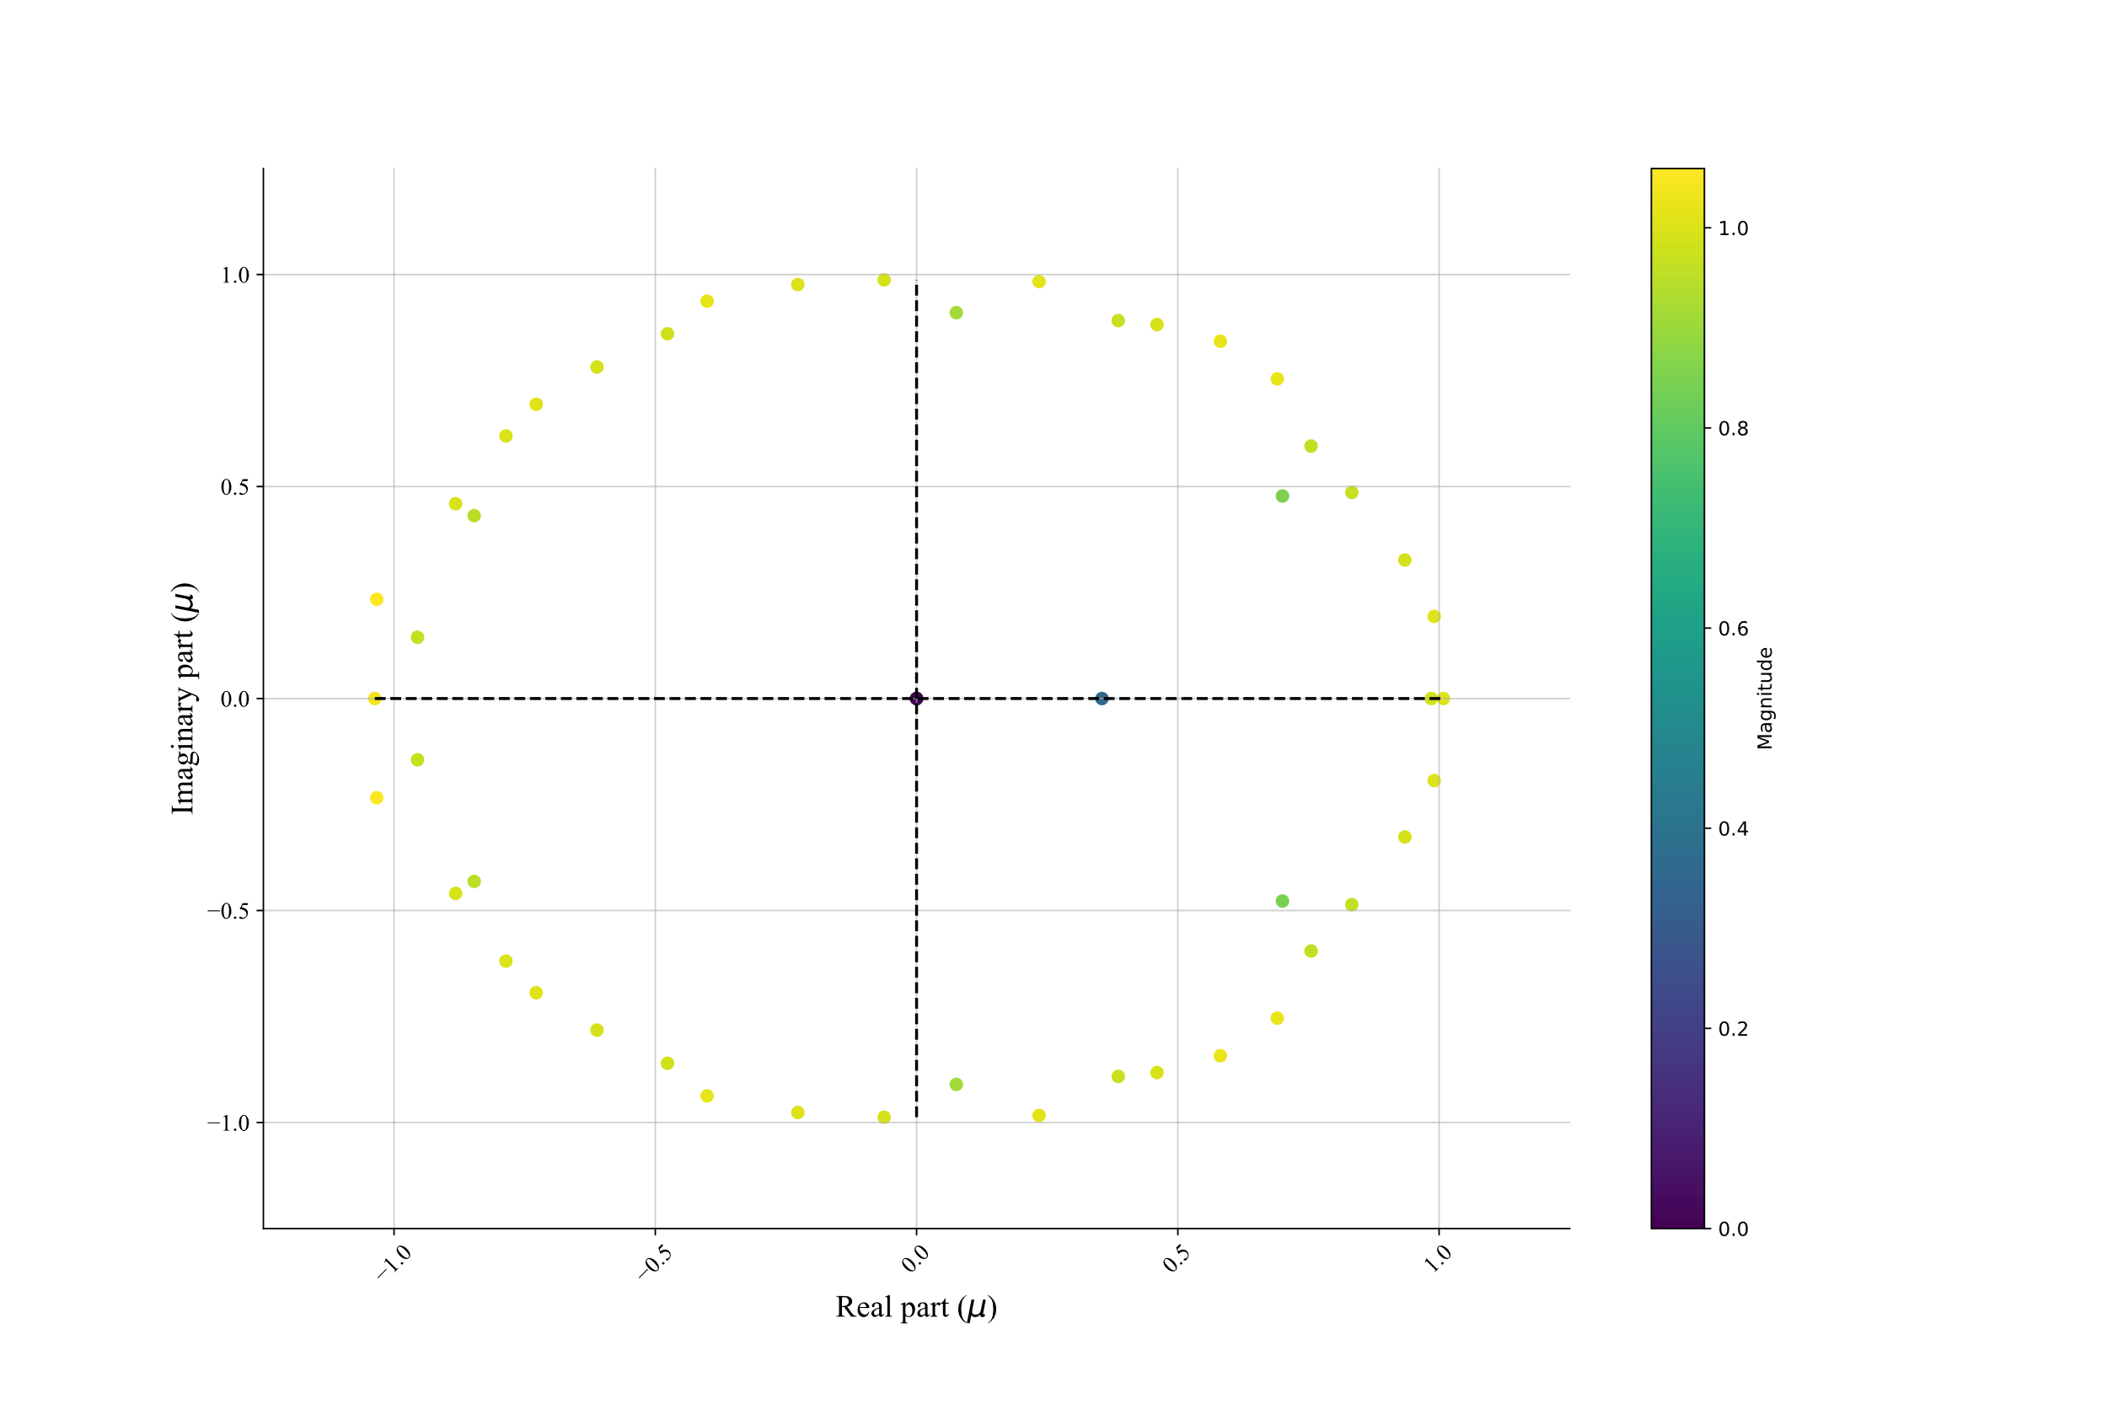

Introduction: The Koopman Operator
Figure 9. The eigen values of the HankelDMD.
Figure 10. The eigen values of the DMD.

Slide 11
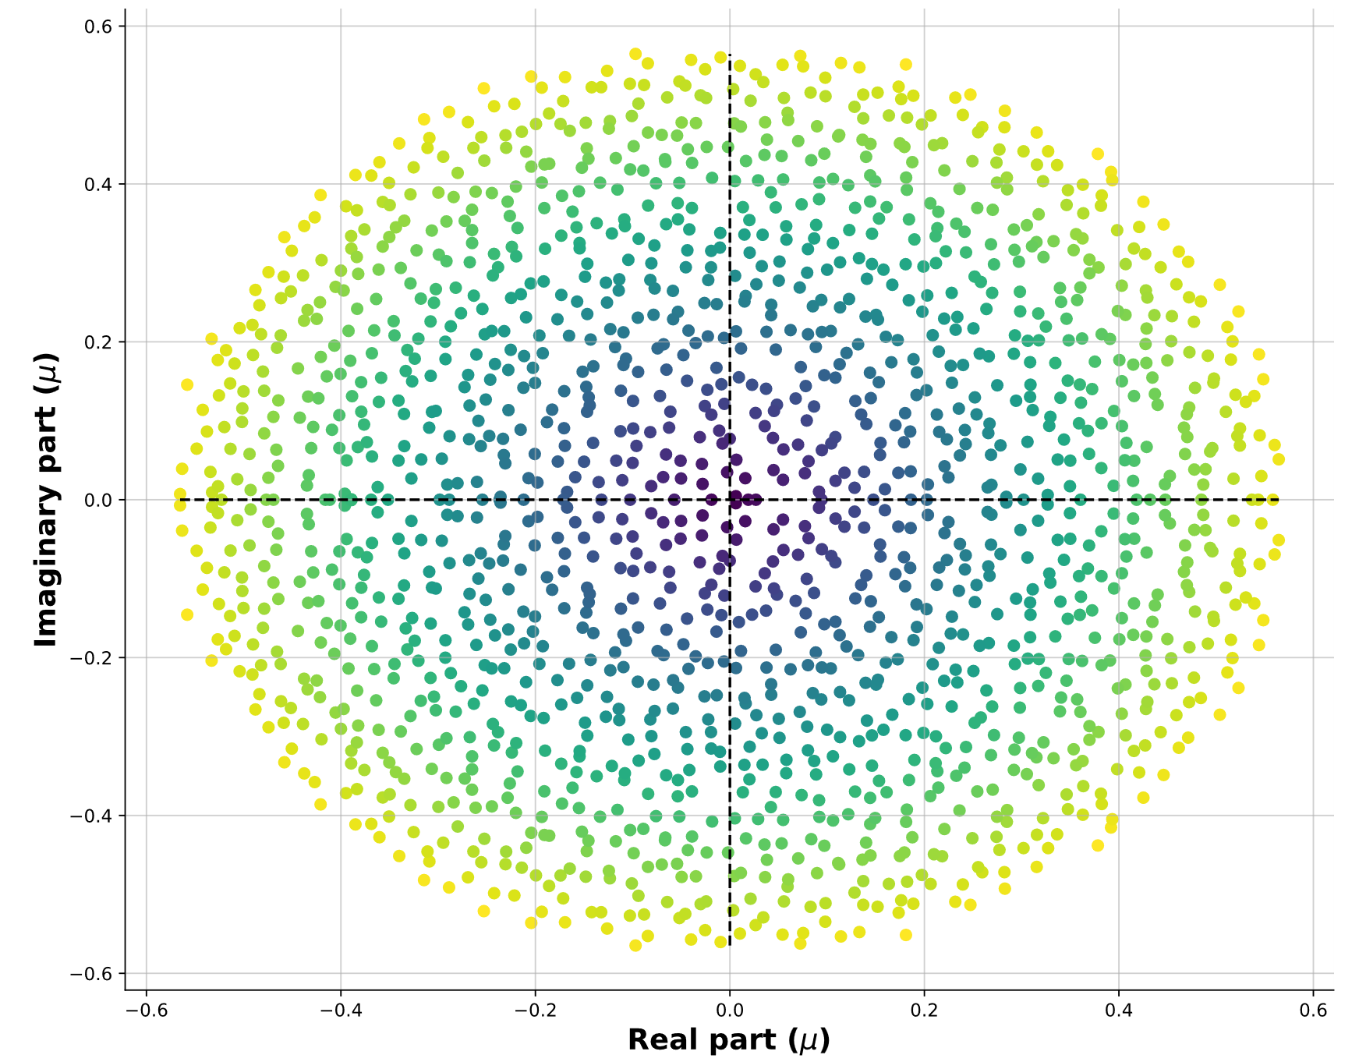
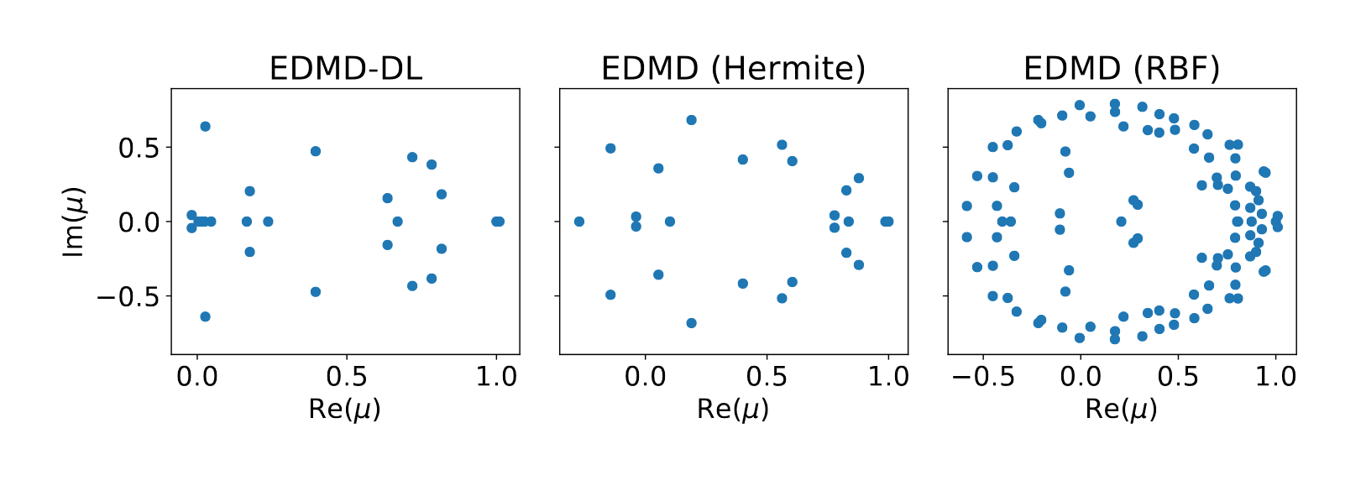
Introduction: The Koopman Operator
Figure 11. Eigen values of the Evolution Matrix (Q. Li, F. Dietrich, E. M. Bollt, and I. G. Kevrekidis)*
*“Extended dynamic mode decomposition with dictionary learning: A data-driven adaptive spectral decomposition of the Koopman operator,”
Figure 12. Eigen values of the Evolution Matrix (Image by Author).

Slide 12
Introduction: The Koopman Operator
FLOPS

